Slide 1

DATA ANALYTICS & BUSINESS INTELLIGENCE

Slide 2
BRIDGING THE GAP BETWEEN MANAGEMENT & TECHNOLOGY

Slide 3
DATA ANALYTICS AND BUSINESS INTELLIGENCE

Slide 4
COURSES
Module 1: Foundation of Data Analytics & Python Programming
Module 2: Probability & Statistics
Module 3: Data Munging with Python
Module 4: Machine learning – Part 1
Module 5: Machine learning – Part 2
Module 6: Optimization in Analytics
Module 7: Introduction to SQL and Business Intelligence

Slide 5
MODULE PROBABILITY & STATISTICS
Descriptive Analytics: Describing and summarizing data sets, measures of central tendency, dispersion, skewness, kurtosis, Correlation.
Probability: Measures of probability, conditional probability, independent event, Bayes’ theorem, random variable, discrete (binomial, Poisson, geometric, hypergeometric, negative binomial) and continuous (uniform, exponential, normal, gamma). Expectation and variance, markov inequality, chebyshev’s inequality, central limit theorem.
Inferential Statistics: Sampling & Confidence Interval, Inference & Significance. Estimation and Hypothesis Testing, Goodness of fit, Test of Independence, Permutations and Randomization Test, ttest/z-test (one sample, independent, paired), ANOVA, chi-square.

Slide 6
REFERENCES
Business Analytics : JAMES EVANS
Statistics for Business : STINE AND FOSTER
Introduction to Probability Models : Sheldon Ross
An Introduction to Statistical Learning with Applications in R : Gareth James, Daniela Witten, Trevor Hastie, Robert Tibshirani
Business Analytics – The Science of Data – Driven Decision Making : U. Dinesh Kumar, Wiley

Slide 7
Random Variables

Slide 8
Random Variables
Will the price of a stock go up or down?
Need language to describe processes that show random behavior (such as stock returns)
“Random variables” are the main components of this language

Slide 9
Definition of a Random Variable
Describes the uncertain outcomes of a random process
Denoted by X
Defined by listing all possible outcomes and their associated probabilities

Slide 10
Suppose a day trader buys one share of IBM
Let X represent the change in price of IBM
She pays $100 today, and the price tomorrow can be either $105, $100 or $95

Slide 11
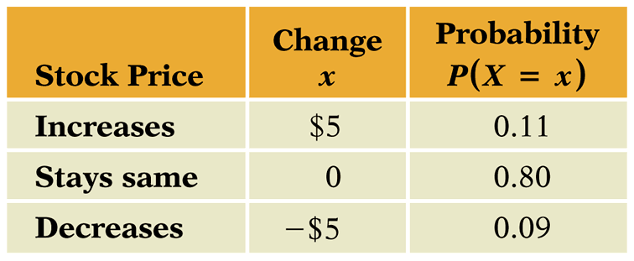
How X is Defined

Slide 12
Two Types: Discrete vs. Continuous
Discrete – A random variable that takes on one of a list of possible values (counts)
Continuous – A random variable that takes on any value in an interval

Slide 13
Examples of discrete random variables:
outcomes of dice rolls
whether a customer likes or dislikes a product
number of hits on a Web site link today
Examples of continuous random variables:
weekly change in DJIA
daily temperature
time between machine failures

Slide 14
Probability Distributions
A probability distribution is a characterization of the possible values that a random variable may assume along with the probability of assuming these values.

Slide 15
Graphs of Random Variables
Show the probability distribution for a random variable
Show probabilities, not relative frequencies from data

Slide 16
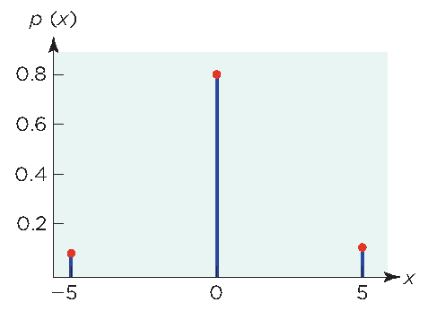
Graph of X = Change in Price of IBM

Slide 17
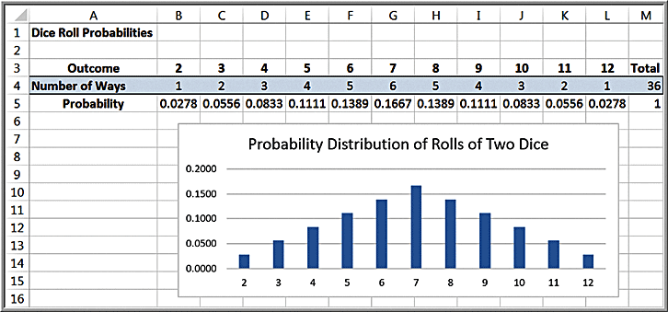
Example: Probability Distribution of Dice Rolls

Slide 18
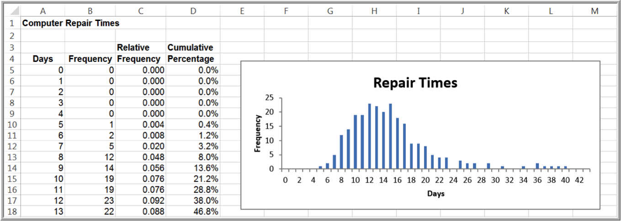
Example: Probability Distribution of Computer Repair Times

Slide 19
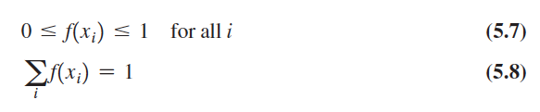
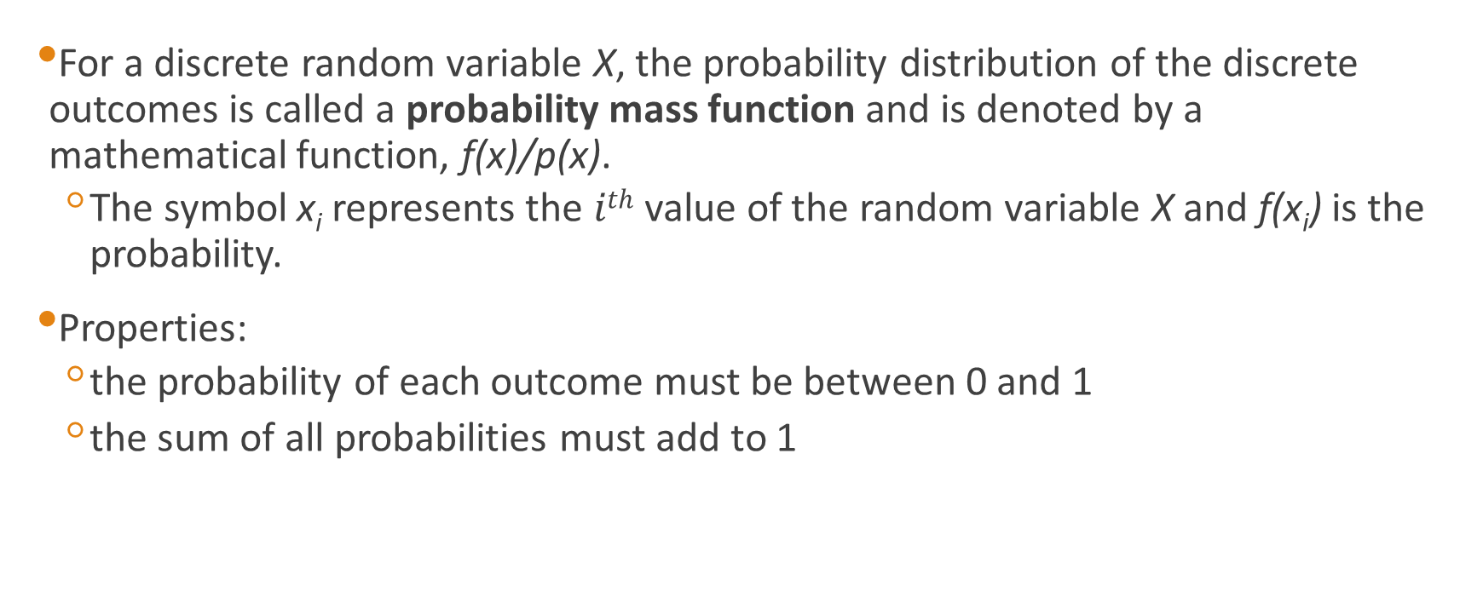
Discrete Probability Distributions
For a discrete random variable X, the probability distribution of the discrete outcomes is called a probability mass function and is denoted by a mathematical function, f(x)/p(x).
The symbol x_{i} represents the $ith$ value of the random variable X and f(x_{i}) is the probability.
Properties:
the probability of each outcome must be between 0 and 1
the sum of all probabilities must add to 1

Slide 20
Example: Probability Mass Function for Rolling Two Dice
x_{i} = values of the random variable X, which represents sum of the rolls of two dice
x₁ = 2, x₂ = 3, …, x₁₀ = 11, x₁₁ = 12
f(x₁) = 1/36 = 0.0278;
f(x₂) = 2/36 = 0.0556, etc.

Slide 21
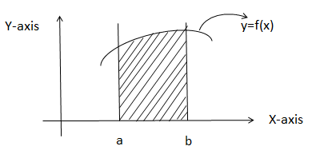
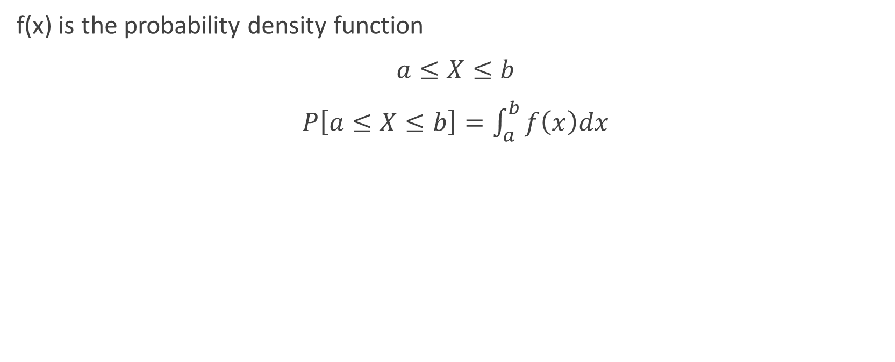
Continuous Probability Distributions
f(x) is the probability density function
$a≤X≤b$
$P\left[a≤X≤b\right]=\int_{a}^{b}{f\left(x\right)dx}$
Y-axis
y=f(x)
X-axis
a
b

Slide 22
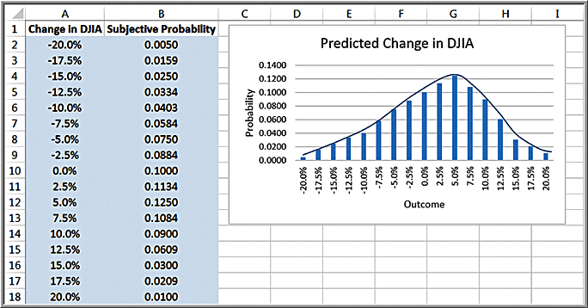
Continuous Probability Distributions (Contd.)
A probability density function is a mathematical function that characterizes a continuous random variable

Slide 23
Continuous Probability Distributions (contd.)
Properties
f(x) ≥ 0 for all values of x
Total area under the density function equals 1.
P(X = x) = 0
Probabilities are only defined over intervals.
P(a ≤ X ≤ b) is the area under the density function between a and b.

Slide 24
Cumulative Distribution Function
A cumulative distribution function, F(a), specifies the probability that the random variable X assumes a value less than or equal to a specified value, x; that is,
F(a) = P(X ≤ a)

Slide 25
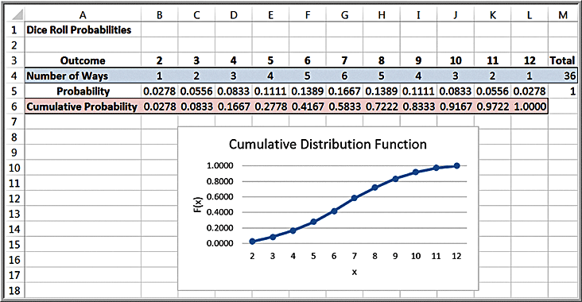
Example: Using the Cumulative Distribution Function
Probability of rolling a 6 or less = F(6) = 0.1667
Probability of rolling between 4 and 8:
= P(4 ≤ X ≤ 8) = P(3 < X ≤ 8) = P(X ≤ 8) – P(X ≤ 3)
= 0.7222 – 0.0833 = 0.6389

Slide 26
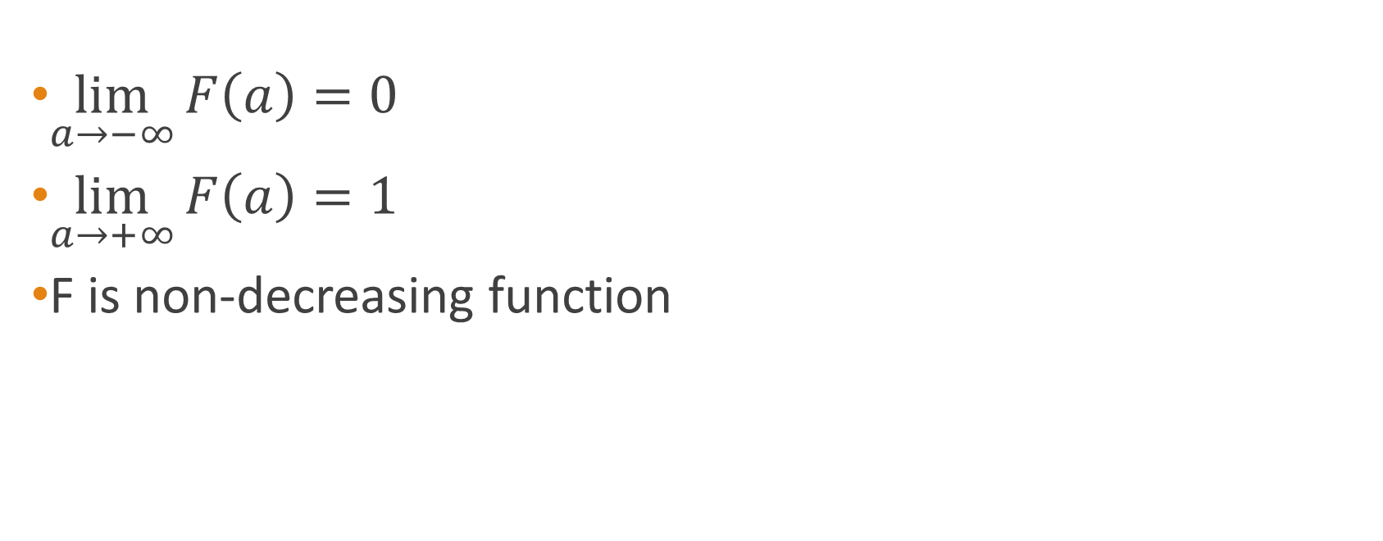
Properties of CDF:
$\lim_{a→−∞}{F\left(a\right)=0}$
$\lim_{a→+∞}{F\left(a\right)=1}$
F is non-decreasing function

Slide 27
Measures of Random Variables

Slide 28
Expectation & Variance

Slide 29
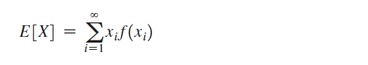
Expected Value of a Discrete Random Variable
The expected value of a random variable corresponds to the notion of the mean, or average, for a sample.
For a discrete random variable X, the expected value, denoted E[X], is the weighted average of all possible outcomes, where the weights are the probabilities:

Slide 30
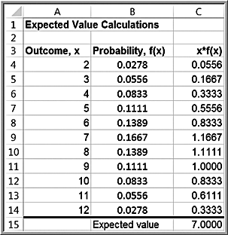
Example: Computing the Expected Value
Rolling two dice
E[X] = 2(0.0278) + 3(0.0556) + 4(0.0833) + 5(0.1111) + 6(0.1389) + 7(0.1667) + 8(0.1389) + 9(0.1111) + 10(0.0833) + 11(0.0556) + 12(0.0278) = 7

Slide 31
Example: Expected Value on Television
The Apprentice
Teams were required to select an artist (mainstream or avant-garde) and sell their art for the most money possible. A back-of-the-envelope expected value calculation would have easily predicted the winner.
Deal or No Deal
Contestant had 5 briefcases left with $100, $400, $1000, $50,000 or $300,000 in them.
Expected value of briefcases is $70,300.
Banker offered contestant $80,000 to quit, which was higher than the expected value. The probability of choosing the $300,000 briefcase was only 0.2, so the decision should have been easy to make.

Slide 32
Expected Value and Decision Making
The expected value is a “long-run average” and is appropriate for decisions that occur on a repeated basis.
For one-time decisions, however, you need to consider the downside risk and the upside potential of the decision.

Slide 33
Airline Revenue Management

Slide 34
Example: Airline Revenue Management
Full and discount airfares are available for a flight.
Full-fare ticket costs $560
Discount ticket costs $400
X = ticket price paid
p = 0.75 (the probability of selling a full-fare ticket)
Expected value of not discounting the price is
E[X] = 0.75($560) + 0.25(0) = $420
The airline should not discount full-fare tickets because the expected value of a full-fare ticket is greater than the cost of a discount ticket.
Break-even point: $400 = p($560) or p = 0.714

Slide 35
Academics (Examination)

Slide 36
Example
An examination paper has 150 multiple-choice questions of one mark each, with each question having four choices. Each incorrect answer fetches -0.25 mark. Suppose 1000 students choose all their answers randomly with uniform probability. The sum total of the expected marks obtained by all these students is
(a) 0
(b) 2550
(c) 7525
(d) 9375

Slide 37
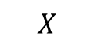
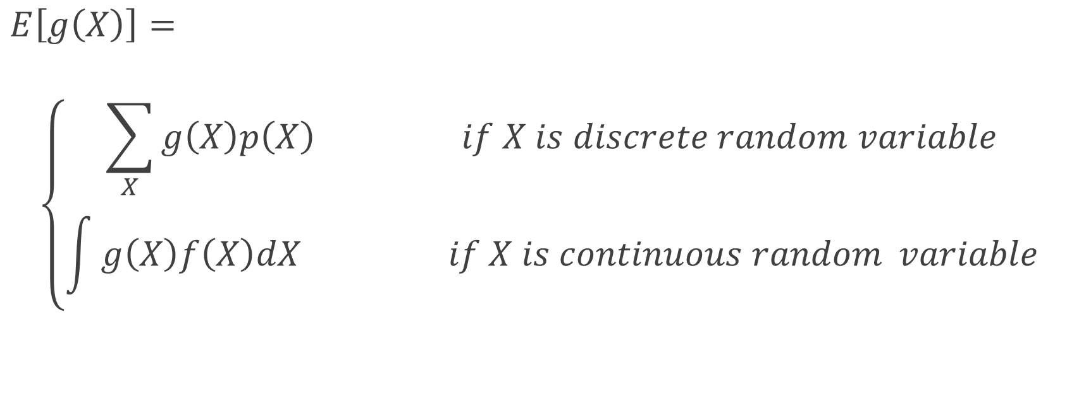
Expectation of Function of Random Variable
$E\left[g\left(X\right)\right]=$
$$\left\{\begin{aligned}\sum_{X}{g\left(X\right)p\left(X\right) if X is discrete random variable} \\ \int{g\left(X\right)f\left(X\right)dX if X is continuous random} variable\end{aligned}\right.$$
$$X$$

Slide 38
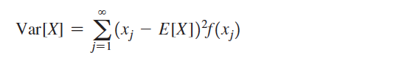
Variance of a Discrete Random Variable
The variance, Var[X], of a discrete random variable X is a weighted average of the squared deviations from the expected value:

Slide 39
Variance (σ²) and Standard Deviation (σ)
The variance of X is the expected value of the squared deviation from µ

Slide 40
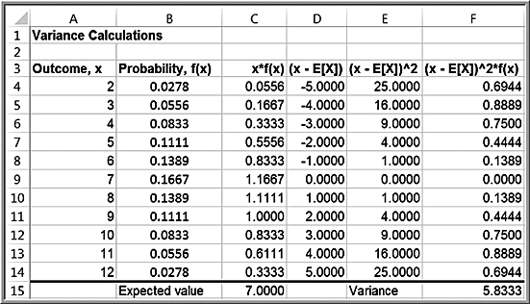
Example: Computing the Variance of a Random Variable
Rolling two dice

Slide 41
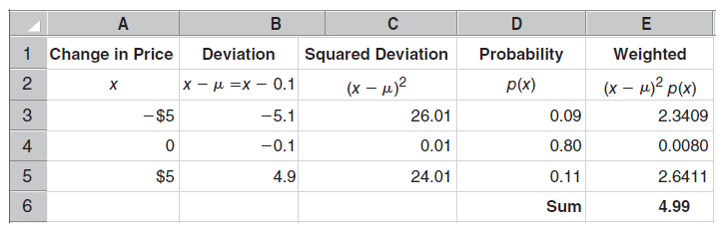
Calculating the Variance (σ² ) for X (prize)

Slide 42
Calculating the Variance (σ² ) for X

Slide 43
The Standard Deviation (σ ) for X

Slide 44
Example: COMPUTER SHIPMENTS & QUALITY
Motivation
CheapO Computers shipped two servers to its biggest client. Four refurbished computers were mistakenly restocked along with 11 new systems. If the client receives two new servers, the profit for the company is $10,000; if the client receives one new server, the profit is $4,500. If the client receives two refurbished systems, the company loses $1000. What are the expected value and standard deviation of CheapO’s profits?

Slide 45
COMPUTER SHIPMENTS & QUALITY (Contd.)
Method
Identify the relevant random variable, X, which is the amount of profit earned on this order. Determine the associated probabilities for its values using a tree diagram. Compute µ and σ.

Slide 46
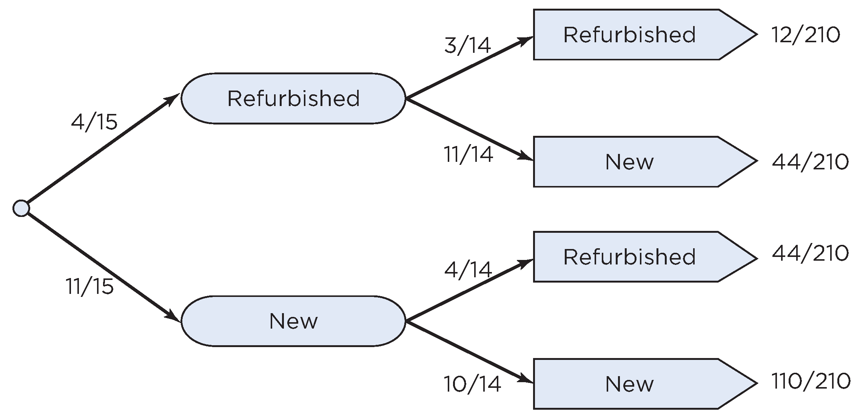
COMPUTER SHIPMENTS & QUALITY (Contd.)
Mechanics – Tree Diagram

Slide 47
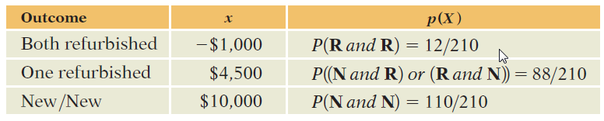
COMPUTER SHIPMENTS & QUALITY (Contd.)
Mechanics – Probabilities for X

Slide 48
COMPUTER SHIPMENTS & QUALITY (Contd.)
Mechanics – Compute µ and σ
E(X) = µ = $7,067
Var(X) = σ² = 10,986,032 $²
SD(X) = σ = $3,315

Slide 49
COMPUTER SHIPMENTS & QUALITY (Contd.)
Message
This is a very profitable deal on average. The large standard deviation is a reminder that profits are wiped out if the client receives two refurbished systems.

Slide 50
Properties of Expected Values
Adding or Subtracting a Constant (c)
Changes the expected value by a fixed amount:
E(X ± c) = E(X) ± c
Does not change the variance or standard deviation:
Var(X ± c) = Var(X)
SD(X ± c) = SD(X)

Slide 51
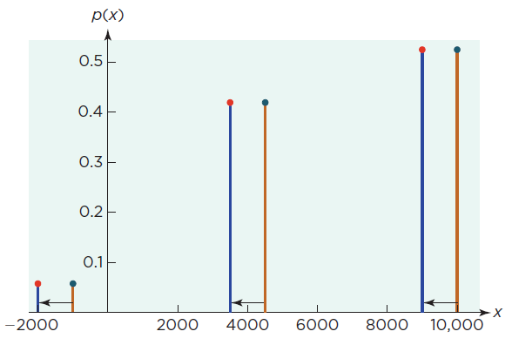
Properties of Expected Values (Contd.)
Subtracting c from Expected Value

Slide 52
Properties of Expected Values (Contd.)
Multiplying by a Constant (c)
Changes the mean and standard deviation by a factor of c:
E(cX) = c E(X)
SD(cX) = |c| SD(X)
Changes the variance by a factor of c²:
Var(cX) = c² Var(X)

Slide 53
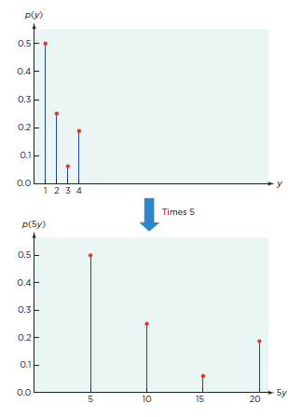
Properties of Expected Values (Contd.)
Multiplying Expected Value by c

Slide 54
Properties of Expected Values (Contd.)
Rules for Expected Values (a and b are constants)
E(a + bX) = a + bE(X)
SD(a + b X) = |b|SD(X)
Var(a + bX) = b²Var(X)

Slide 55
Comparing Random Variables
May require transforming random variables into new ones that have a common scale
May require adjusting if the results from the mean and standard deviation are mixed

Slide 56
Comparing Random Variables (Contd.)
The Sharpe Ratio
Popular in finance
Is the ratio of an investment’s net expected gain to its standard deviation

Slide 57
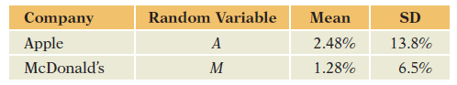
Comparing Random Variables (Contd.)
The Sharpe Ratio – An Example
S(Apple) = 0.151
S(McDonald’s) = 0.135
Apple is preferred to McDonald’s

Slide 58
Best Practices
Use random variables to represent uncertain outcomes.
Draw the random variable.
Recognize that random variables represent models.
Keep track of the units of a random variable.

Slide 59
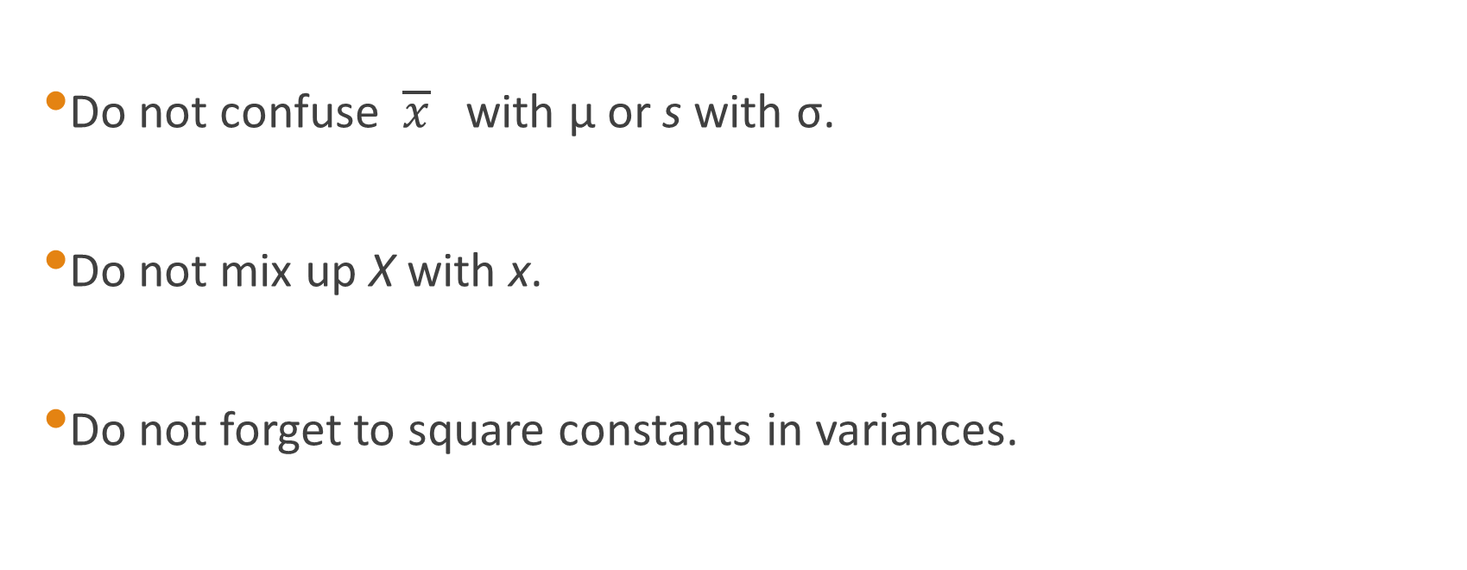
Pitfalls
Do not confuse $\overline{x}$ with µ or s with σ.
Do not mix up X with x.
Do not forget to square constants in variances.

Slide 60
Probability Models
for Counts

Slide 61
Random Variables for Counts
How many doctors should management expect a detail rep to meet in a day if only 40% of visits reach a doctor? Is a rep who visits 8 or more doctors in a day doing exceptionally well?
Need a discrete random variable to model counts and provide a method for finding probabilities

Slide 62
Random Variables for Counts (Contd.)
Bernoulli Random Variable
Bernoulli trials are random events with three characteristics:
Two possible outcomes (success, failure)
Fixed probability of success (p)
Independence

Slide 63
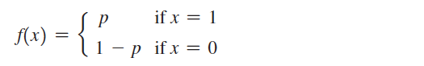
Bernoulli Distribution
Two possible outcomes, “success” and “failure,” each with a constant probability of occurrence; p is the probability of a success and 1 – p is the probability of a failure
Typically, x = 1 represents “success” and x = 0 represents “failure”
Probability mass function:
E[X] = p
Var[X] = p(1 − p)

Slide 64
Example: Using the Bernoulli Distribution
The Bernoulli distribution can be used to model whether an individual responds positively (x = 1), or negatively (x = 0) to a telemarketing promotion.
For example, if you estimate that 20% of customers contacted will make a purchase, the probability distribution that describes whether or not a particular individual makes a purchase is Bernoulli with p = 0.2

Slide 65
Random Variables for Counts (Contd.)
Counting Successes (Binomial)
Y, the sum of i.i.d Bernoulli random variables, is a binomial random variable
Y = number of success in n Bernoulli trials (each trial with probability of success = p)
Defined by two parameters: n and p

Slide 66
Random Variables for Counts (Contd.)
Counting Successes (Binomial)
We can define the number of doctors seen by a pharmaceutical rep in 10 visits as a binomial random variable
This random variable, Y, is defined by
n = 10 visits and p = 0.40 (40% success in reaching a doctor)

Slide 67
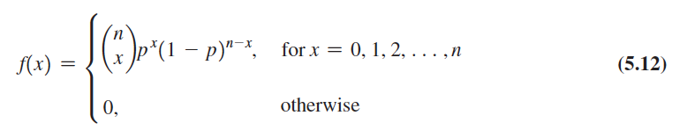
Binomial Distribution
Models n independent replications of a Bernoulli experiment, each with a probability p of success.
X represents the number of successes in these n experiments
Probability mass function:

Slide 68
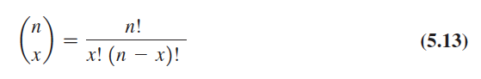
Binomial Distribution (Contd.)
The number of ways of choosing x distinct items from a group of n items and is
where n! (n factorial) = n(n - 1)(n - 2) . . . (2)(1), and 0! is defined as 1.
Expected value = np; variance = np(1 – p)

Slide 69
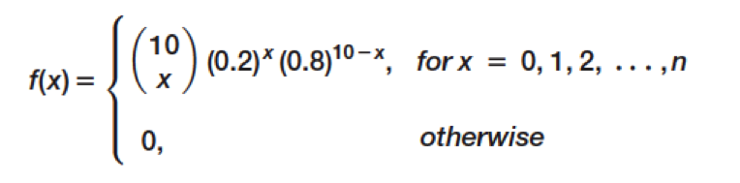
Example: Computing Binomial Probabilities
Suppose 10 individuals receive a telemarking promotion. Each individual has a 0.2 probability of making a purchase. Find the probability that exactly 3 of the 10 individuals make a purchase.
The probability distribution that x individuals out of 10 calls will make a purchase is:

Slide 70
Example: Computing Binomial Probabilities (Contd.)
Excel function:
=BINOM.DIST(number_s, trials, probability_s, cumulative)
If cumulative is set to TRUE, then this function will provide cumulative probabilities; otherwise the default is FALSE, and it provides values of the probability mass function, f(x).

Slide 71
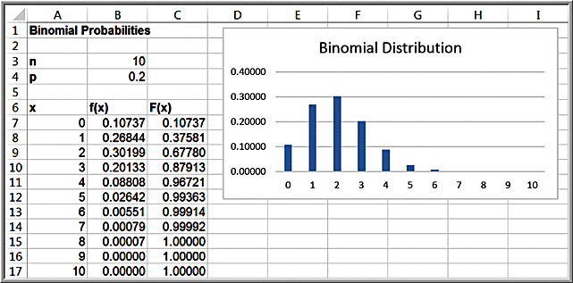
Example: Using Excel’s Binomial Distribution Function
The probability that exactly 3 of 10 individuals will make a purchase is P(x = 3): =BINOM.DIST(3,10,0.2,FALSE) = 0.20133
The probability that 3 or fewer of 10 individuals will make a purchase is P(x ≤ 3): =BINOM.DIST(3,10,0.2,TRUE) = 0.87913

Slide 72
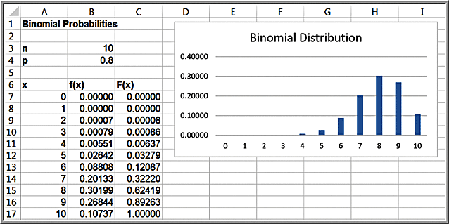
Shapes and Skewness of the Binomial Distribution
The binomial distribution is symmetric when p = 0.5; positively skewed when p < 0.5, and negatively skewed when p > 0.5.
Example of negatively-skewed distribution

Slide 73
Pharmaceutical Rep Example (Contd.)
E(Y) = np = (10)(0.40) = 4
We expect a rep to see 4 doctors in 10 visits.
Var(Y) = np(1 - p) = (1)(0.40)(0.60) = 2.4
SD(Y) = 1.55
A rep who has seen 8 doctors has performed 2.6 standard deviations above the mean.

Slide 74
Pharmaceutical Rep Example (Contd.)
P(Y = 8) = ₁₀C₈(0.4)⁸(0.6)² = 0.011
The probability of seeing 8 doctors in 10 visits is only about 1%.

Slide 75
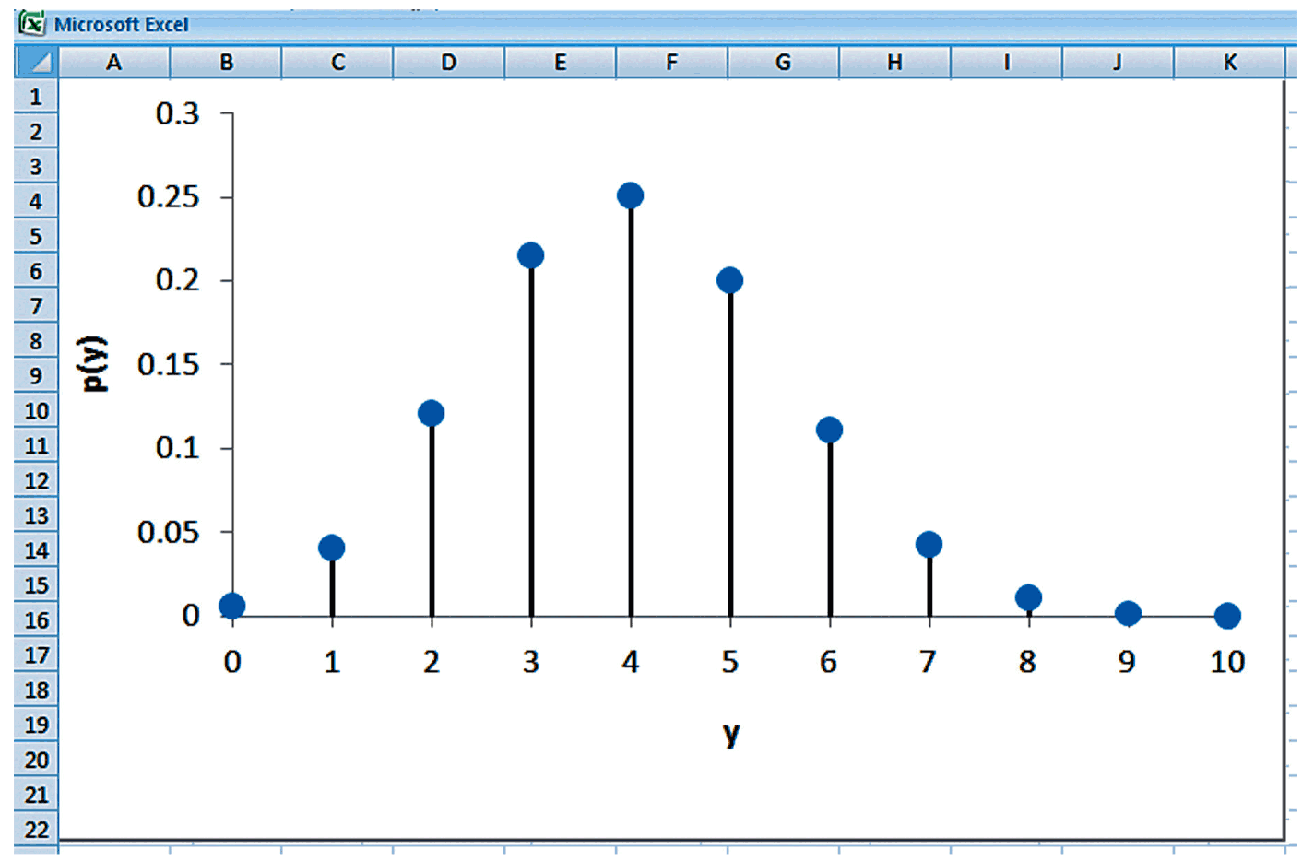
Probability Distribution for Rep Example

Slide 76
Pharmaceutical Rep Example (Contd.)
P(Y ≥ 8)= P(Y = 8) + P(Y = 9) + P(Y = 10)
= 0.01062 + 0.00157 + 0.00010
= 0.01229
The probability of seeing 8 or more doctors in 10 visits is only slightly above 1%. This rep is doing exceptionally well!

Slide 77
FOCUS ON SALES
Motivation
A focus group with nine randomly chosen participants was shown a prototype of a new product and asked if they would buy it at a price of $99.95. Six of them said yes. The development team claimed that 80% of customers would buy the new product at that price. If the claim is correct, what results would we expect from the focus group?

Slide 78
FOCUS ON SALES (Contd.)
Method
Use the binomial model for this situation. Each focus group member has two possible responses: yes, no. We can use Y ~ Bi(n = 9, p = 0.8) to represent the number of yes responses out of nine.

Slide 79
FOCUS ON SALES (Contd.)
Mechanics – Find E(Y) and SD(Y)
E(Y) = np = (9)(0.8) = 7.2
Var(Y) = np(1-p) = (9)(0.8)(0.2) = 1.44
SD(Y) = 1.2
The expected number is higher than the observed number of 6.

Slide 80
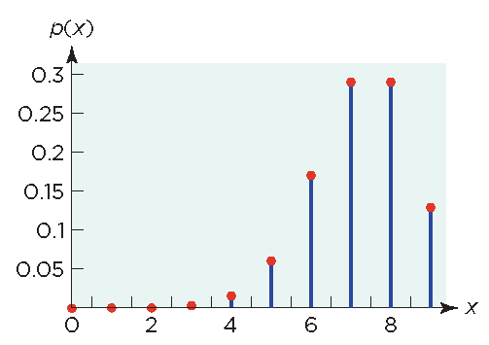
FOCUS ON SALES (Contd.)
Mechanics – Probability Distribution
P(Y=6) = 0.18. While 6 is not the most likely outcome, it is still common.

Slide 81
FOCUS ON SALES (Contd.)
Message
The results of the focus group are in line with what we would expect to see if the development team’s claim is correct.

Slide 82
Poisson Model
A Poisson Random Variable
Describes the number of events determined by a random process during an interval of time or space
Is not finite (possible values are infinite)
Is defined by λ (lambda), the rate of events

Slide 83
Poisson Model (Contd.)
The Poisson Probability Distribution
E(X) = λ, Var(X) = λ

Slide 84
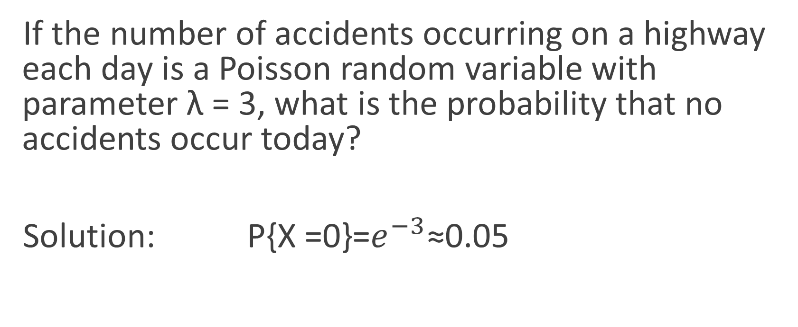
Example
If the number of accidents occurring on a highway each day is a Poisson random variable with parameter λ = 3, what is the probability that no accidents occur today?
Solution: P{X =0}=$e^{−3}$≈0.05

Slide 85
DEFECTS IN SEMICONDUCTORS
Motivation
A supplier claims that its wafers have 1 defect per 400 cm². Each wafer is 20 cm in diameter, so the area is 314 cm². What is the mean number of defects and the standard deviation?

Slide 86
DEFECTS IN SEMICONDUCTORS (Contd.)
Method
The random variable is the number of defects on a randomly selected wafer.
The Poisson model applies.

Slide 87
DEFECTS IN SEMICONDUCTORS (Contd.)
Mechanics – Find λ
The assumed defect rate is 1 per 400 cm².
Since a wafer has an area of 314 cm²,
λ = 314/400 = 0.785
E(X) = 0.785
SD(X) = 0.886
P(X = 0) = 0.456

Slide 88
DEFECTS IN SEMICONDUCTORS (Contd.)
Message
The chip maker can expect about 0.8 defects per wafer. About 46% of the wafers will be defect free.

Slide 89
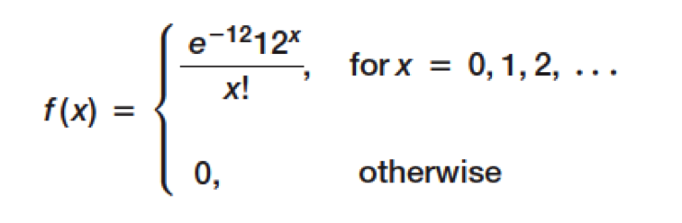
Example: Computing Poisson Probabilities
Suppose the average number of customers arriving at a Subway restaurant during lunch hour is λ =12 per hour.
The probability that exactly x customers arrive during the hour is given by the Poisson distribution with a mean of 12.
Excel function: =POISSON.DIST(x, mean, cumulative)

Slide 90
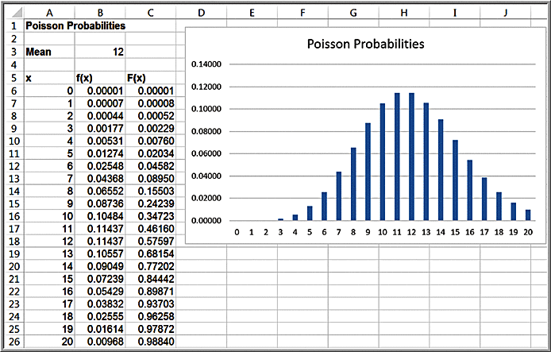
Example: Using Excel’s Poisson Distribution Function
With λ = 12, the probability that X = 1 is
=POISSON.DIST(A7,$B$3,FALSE) = 0.00007
The probability that X ≤ 4 is
=POISSON.DIST(A10,$B$3,TRUE) = 0.00760

Slide 91
Best Practices
Ensure that you have Bernoulli trials if you are going to use the binomial model.
Use the binomial model to simplify the analysis of counts.
Use the Poisson model when the count accumulates during an interval.

Slide 92
Best Practices (Contd.)
Check the assumptions of a model.
Use a Poisson model to simplify counts of rare events.

Slide 93
Pitfalls
Do not presume independence without checking.
Do not assume stable conditions routinely.

Slide 94
Geometric Random Variable

Slide 95
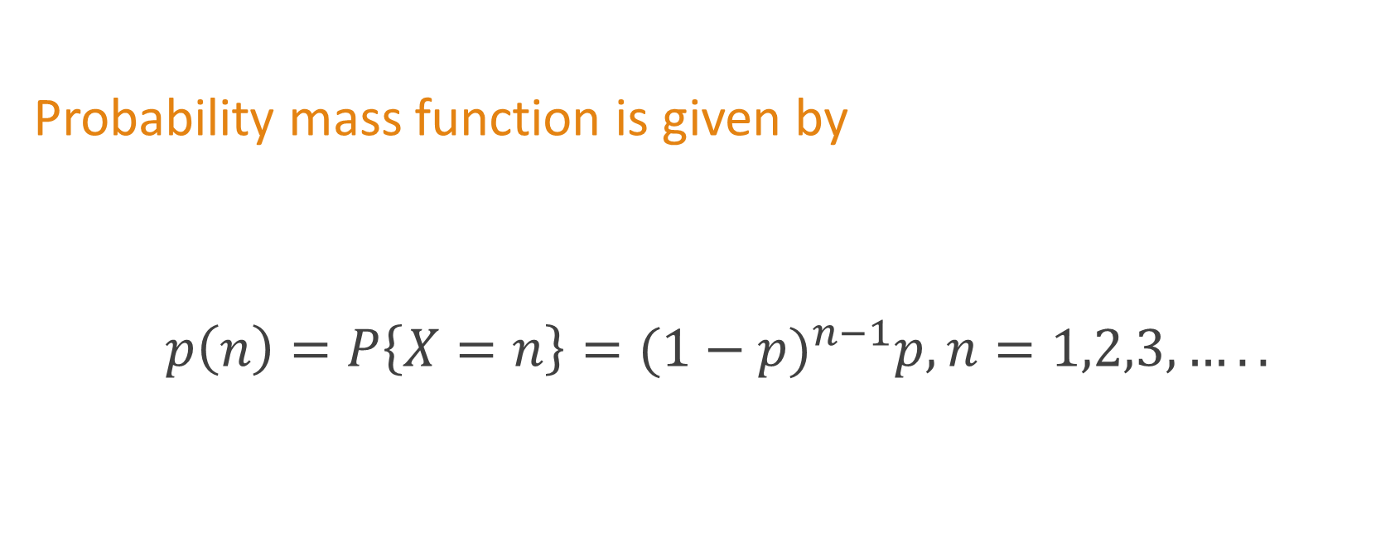
Geometric Distribution
Probability mass function is given by
$${p\left(n\right)=P\left\{X=n\right\}=(1−p)}^{n−1}p,n=1,2,3,…..$$

Slide 96
Hypergeometric Random Variable

Slide 97
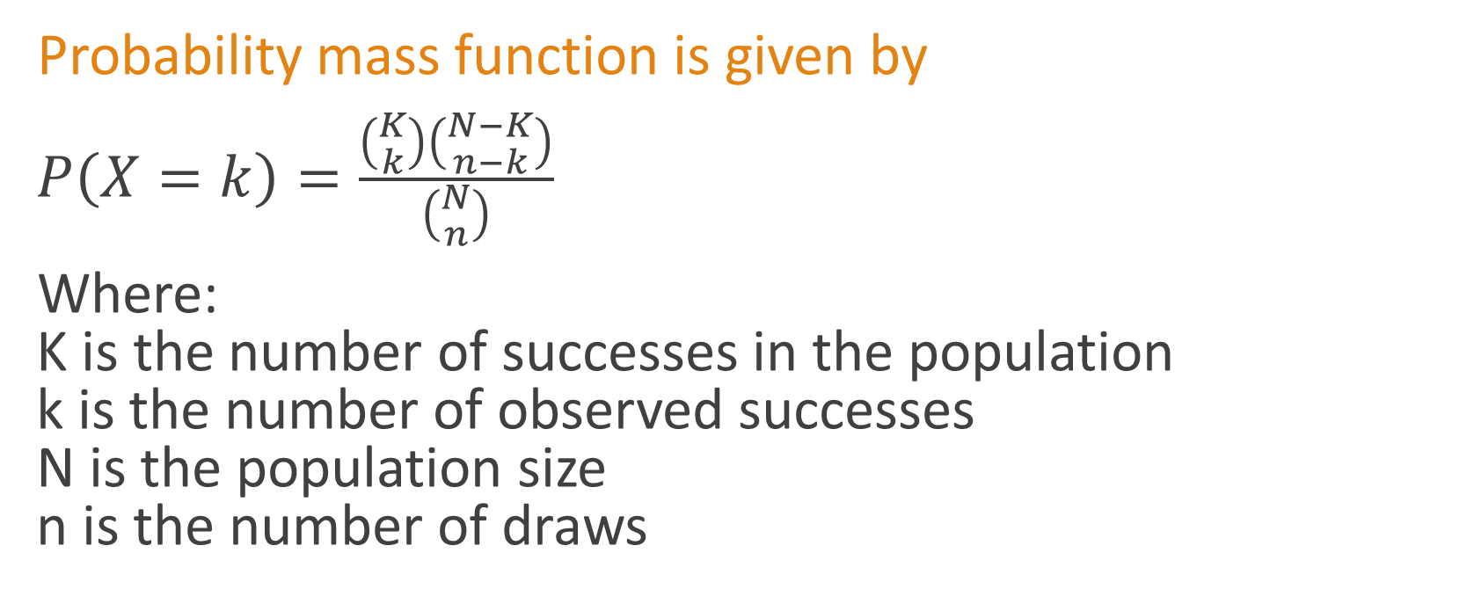
Hypergeometric Distribution
Probability mass function is given by
$P\left(X=k\right)=\frac{\left({K \atop k}\right)\left({N−K \atop n−k}\right)}{\left({N \atop n}\right)}$
Where: K is the number of successes in the population k is the number of observed successes N is the population size n is the number of draws

Slide 98
Negative binomial
Random Variable

Slide 99
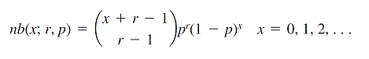
Negative Binomial Distribution
Probability mass function is given by
Where: r is the number of successes and p = the probability of success.

Slide 100
Special Continuous
Probability Distributions

Slide 101
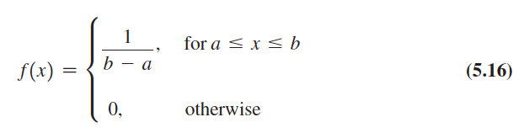
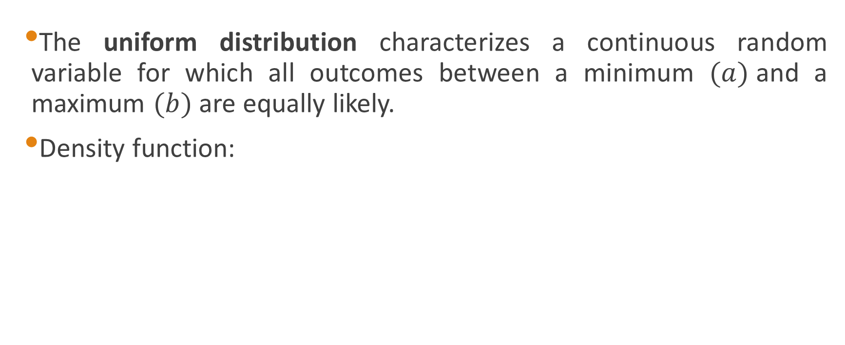
Uniform Distribution
The uniform distribution characterizes a continuous random variable for which all outcomes between a minimum $(a)$and a maximum $(b)$ are equally likely.
Density function:

Slide 102
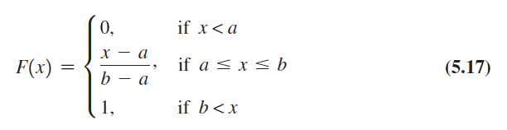
Uniform Distribution (Contd.)
Cumulative distribution function:
Expected value = (a + b)/2; variance = (b – a)²/12

Slide 103
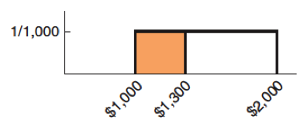
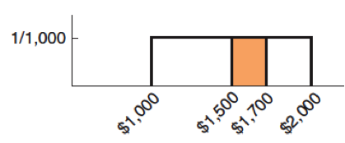
Example: Computing Uniform Probabilities
Sales revenue for a product varies uniformly each week between $1000 and $2000.
Probability that sales revenue will be less than x = $1,300.
F(1,300) = (1,300 - 1,000) / (2,000 - 1,000) = 0.30
Probability that revenue will be between $1,500 and $1,700.
P(1,500 ≤ X ≤ 1,700) = P(X ≤ 1,700) - P(X ≤ 1,500) = F(1,700) - F(1,500) = F(1,700) - F(1,500) = 0.7 – 0.5 = 0.2

Slide 104
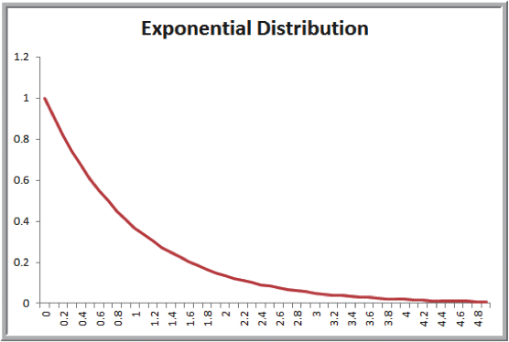
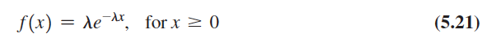
Exponential Distribution
Models the time between randomly occurring events
Density function:
Cumulative distribution function:
Mean = μ = 1/λ
Excel function:=EXPON.DIST(x, lambda, cumulative)
If the number of events occurring during an interval of time has a Poisson distribution, then the time between events is exponentially distributed.

Slide 105
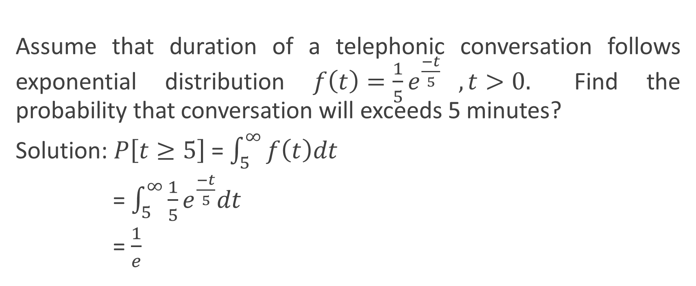
Example of Exponential Distribution
Assume that duration of a telephonic conversation follows exponential distribution $f\left(t\right)=\frac{1}{5}e^{\frac{−t}{5}} , t>0.$ Find the probability that conversation will exceeds 5 minutes?
Solution: $P\left[t≥5\right]$= $\int_{5}^{∞}{f\left(t\right)dt}$
= $\int_{5}^{∞}{\frac{1}{5}e^{\frac{−t}{5}}dt}$
= $\frac{1}{e}$

Slide 106
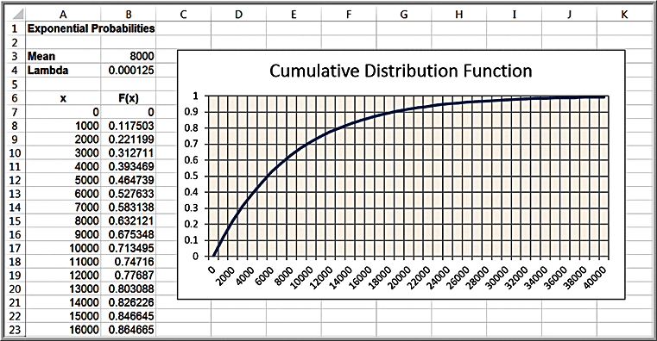
Example: Using the Exponential Distribution
The mean time to failure of a critical engine component is µ = 8,000 hours. What is the probability of failing before 5000 hours?
P(X < x) =EXPON.DIST(x, lambda, cumulative)
λ = 1/8000
P(X < 5000)
=EXPON.DIST(5000, 1/8000, TRUE)
= 0.4647

Slide 107
Normal Probability Model

Slide 108
Normal Random Variable
Black Monday (October, 1987) prompted investors to consider insurance against another “accident” in the stock market. How much should an investor expect to pay for this insurance?
Insurance costs call for a random variable that can represent a continuum of values (not counts)

Slide 109
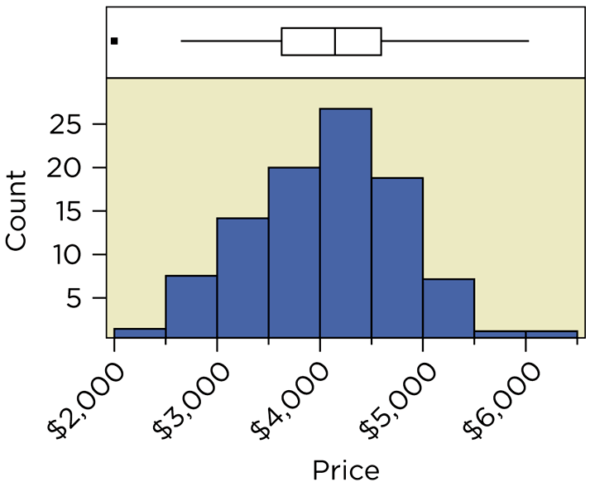
Normal Random Variable (Contd.)
Prices for One-Carat Diamonds

Slide 110
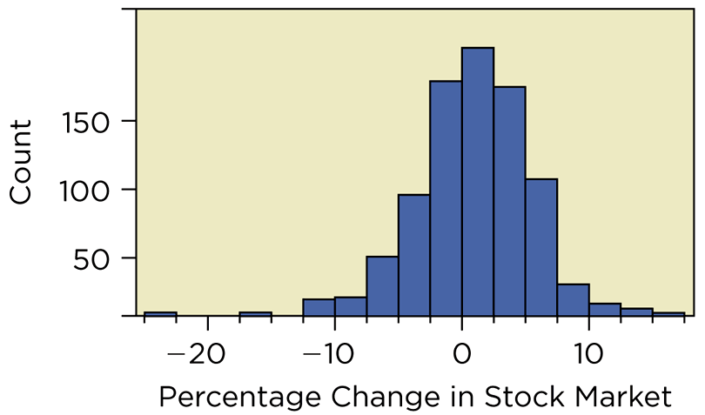
Normal Random Variable (Contd.)
Percentage Change in Stock Market

Slide 111
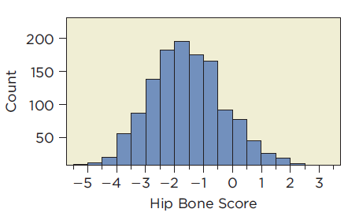
Normal Random Variable (Contd.)
X-ray Measurements of Bone Density

Slide 112
Normal Random Variable (Contd.)
With the exception of Black Monday, the histogram of market changes is bell-shaped
Histograms of diamond prices and bone density measurements are bell-shaped
All three involve a continuous range of values; all three can be modeled using normal random variables

Slide 113


Normal Distribution
X is a normal random variable (or simply that X is normally distributed) with parameters μ and $σ^{2}$ if the density of X is given by

Slide 114
Normal Random Variable (Contd.)
Normal Probability Distribution
A normal random variable is continuous and can assume any value in an interval
Probability of an interval is area under the distribution over that interval (note: total area under the probability distribution is 1)

Slide 115

Normal Random Variable (Contd.)
Probabilities are Areas Under the Curve

Slide 116

3 sigma limits of Normal Distribution

Slide 117

Normal Distributions with Different µ’s

Slide 118

Normal Distributions with Different σ²’s

Slide 119

Normal Distribution
f(x) is a bell-shaped curve
Characterized by 2 parameters:
μ (mean)
σ (standard deviation)
Properties
Symmetric
Mean = Median = Mode
Range of X is unbounded
Empirical rules apply

Slide 120
Computing Normal Probabilities
Excel function:=NORM.DIST(x, mean, standard_deviation, cumulative).
NORM.DIST(x, mean, standard_deviation, TRUE) calculates the cumulative probability
If cumulative is set to FALSE, the function simply calculates the value of the density function f(x), which has little practical application.

Slide 121

Example: Using the NORM.DIST Function to Compute Normal Probabilities
The distribution for customer demand (units per month) is normal with mean = 750 and standard deviation = 100
Find the probability that demand will be:
1. at most 900 units/month
2. exceed 700 units/month
3. be between 700 and 900
units/month

Slide 122

Example: Question 1
Probability that demand will be at most 900 units, or P(X ≤ 900):
=NORM.DIST(900,750,100,TRUE) = 0.9332.

Slide 123

Example: Question 2
Probability that demand will exceed 700 units, or P(X > 700).
=1-NORM.DIST(700,750,100,TRUE) = 1 - 0.3085 = 0.6915

Slide 124

Example: Question 3
Probability that demand will be between 700 and 900, or P(700 < X < 900):
=NORM.DIST(900,750,100,TRUE) - NORM.DIST(700,750,100,TRUE) =0.9332 - 0.3085 = 0.6247

Slide 125
The NORM.INV Function
Normal Inverse function:
=NORM.INV(probability, mean, stdev) provides the x value with
F(x) = probability

Slide 126

Example: Using the NORM.INV Function
What level of demand would be exceeded at most 10% of the time?
Find x such that F(x) = 0.90:
= NORM.INV(0.90, 750, 100) = 878.155

Slide 127

Standard Normal Distribution
A standard normal distribution is a normal distribution with a mean of 0 and standard deviation of 1.
A standard normal random variable is denoted by Z.
The scale along the z-axis represents the number of standard deviations from the mean of zero.
The Excel function =NORM.S.DIST(z)
finds probabilities for the standard
normal distribution.

Slide 128

Example: Computing Probabilities with the Standard Normal Distribution
Verify the empirical rules using Excel.
Example: The probability within one standard deviation of the mean is P(-1 < Z < 1)
= NORMS.DIST(1) – NORMS.DIST(-1)
= 0.84134 – 0.15866
= 0.6827
~ 68%

Slide 129



Using Standard Normal Distribution Tables
Table 1 of Appendix A
We may compute probabilities for any normal random variable X having a mean μ and standard deviation σ by converting it to a standard normal random variable Z:

Slide 130

Example: Computing Probabilities with Standard Normal Tables
From Example 5.30, what is the probability that demand will be at least 900 units/month?
z = (900 − 750)/100 = 1.50
Using Table 1 in Appendix A, we find:
P(X < 900) = P(Z < 1.50) = 0.93319

Slide 131

The Normal Model
Normal Model for Diamond Prices
Set µ = $4,066 and σ = $738.

Slide 132

SATS AND NORMALITY
Method – Use the Normal Model

Slide 133

SATS AND NORMALITY (Contd.)
Mechanics
A math SAT score of 600 is equivalent z = 1. Using the empirical rule, we find that 15.85% of test takers score 600 or better.

Slide 134
SATS AND NORMALITY (Contd.)
Message
About one-sixth of those who take the math SAT score 600 or above. Although not that common, a company can expect to find candidates who meet this requirement.

Slide 135
Example:
A class of first year B.Tech. students is composed of four batches A, B, C and D, each consisting of 30 students. It is found that the sessional marks of students in Engineering Drawing in batches C have a mean of 6.6 and standard deviation of 2.3. The mean and standard deviation of the marks for the entire class are 5.5 and 4.2, respectively. It is decided by the course instructor to normalize the marks of the students of all batches to have the same mean and standard deviation as that of the entire class. Due to this, the marks of a student in batch C are changed from 8.5 to
(a) 6.0
(b) 7.0
(c) 8.0
(d) 9.0

Slide 136

Solution
$Z=\frac{X−μ}{σ}=\frac{X−5.5}{4.2}$
$Z_{c}=\frac{X_{c}−μ_{c}}{σ_{c}}=\frac{8.5−6.6}{2.3}$
Equating these two and solving, we get
$\frac{8.5−6.6}{2.3}=\frac{X−5.5}{4.2}$
$X=8.969≈9.0$

Slide 137
Limit Theorems

Slide 138


Markov inequality
If X is a random variable that takes only non-negative values, then for any value a > 0

Slide 139


Chebyshev’s Inequality
If X is a random variable with mean μ and variance $σ^{2}$, then, for any value k > 0,

Slide 140

Example
Suppose we know that the number of items produced in a factory during a week is a random variable with mean 500.
(1). What can be said about the probability that this week’s production will be at least 1000?
Solution:

Slide 141


Solution
(2). If the variance of a week’s production is known to equal 100, then what can be said about the probability that this week’s production will be between 400 and 600?
Solution:
and so the probability that this week’s production will be between 400 and 600 is at least 0.99

Slide 142



Central Limit Theorem
Let X1,X2, . . . be a sequence of independent, identically distributed random variables, each with mean μ and variance $σ^{2}$. Then the distribution of
Tends to the standard normal as n→∞. That is,
as n→∞.

Slide 143
Normal Approximation to
Binomial distribution

Slide 144


Example: 1
Let X be the number of times that a fair coin, flipped 40 times, lands heads. Find the probability that X = 20. Use the normal approximation and then compare it to the exact solution.
Solution:

Slide 145


Example: 2
Let $X_{i}$, $i$ = 1, 2, . . . , 10 be independent random variables, each being uniformly distributed over (0, 1). Estimate $P\{\sum_{1}^{10}{X_{i}>7}\}$.
Solution:

Slide 146
Example: 3
The lifetime of a special type of battery is a random variable with mean 40 hours and standard deviation 20 hours. A battery is used until it fails, at which point it is replaced by a new one. Assuming a stockpile of 25 such batteries, the lifetimes of which are independent, approximate the probability that over 1100 hours of use can be obtained.

Slide 147

Solution

Slide 148
Moment Generating Functions

Slide 149

Moment Generating Functions
The moment generating function φ(t) of the random variable X is defined for all values t by

Slide 150



Characteristics:
Mean=
also
Variance =$∅^{′′}\left(0\right)−{[∅^{′}\left(0\right)]}^{2}$

Slide 151

Table: 1

Slide 152

Table: 2

Slide 153
Association between
Random Variables

Slide 154
Portfolios and Random Variables
How should money be allocated among several stocks that form a portfolio?
Need to manipulate several random variables at once to understand portfolios
Since stocks tend to rise and fall together, random variables for these events must capture dependence

Slide 155
Portfolios and Random Variables (Contd.)
Two Random Variables
Suppose a day trader can buy stock in two companies, IBM and Microsoft, at $100 per share
X denotes the change in value of IBM
Y denotes the change in value of Microsoft

Slide 156

Portfolios and Random Variables (Contd.)
Probability Distribution for the Two Stocks

Slide 157
Portfolios and Random Variables (Contd.)
Comparisons and the Sharpe Ratio
The day trader can invest $200 in
Two shares of IBM;
Two shares of Microsoft; or
One share of each

Slide 158

Portfolios and Random Variables (Contd.)
Which portfolio should she choose?

Slide 159
Joint Probability Distribution
Find Sharpe Ratio for Two Stock Portfolio
Combines two different random variables (X and Y) that are not independent
Need joint probability distribution that gives probabilities for events of the form (X = x and Y = y)

Slide 160

Joint Probability Distribution (Contd.)
Joint Probability Distribution of X and Y

Slide 161
Joint Probability Distribution (Contd.)
Independent Random Variables
Two random variables are independent if (and only if) the joint probability distribution is the product of the marginal distributions.
p(x,y) = p(x)×p(y) for all x,y

Slide 162
Joint Probability Distribution (Contd.)
Multiplication Rule
The expected value of a product of independent random variables is the product of their expected values.
E(XY) = E(X)E(Y)

Slide 163
Example: EXCHANGE RATES
Motivation
A firm’s sales in Europe average 10 million € each month. The current exchange rate is 1.40$/€ but it fluctuates. What should this firm expect for the dollar value of European sales next month?

Slide 164

Example: EXCHANGE RATES (Contd.)
Motivation
Fluctuating Exchange Rates

Slide 165
Example: EXCHANGE RATES (Contd.)
Method
Identify three random variables:
S = sales next month in €;
R = exchange rate next month; and
D = value of sales in $.
These are related by D = S×R. Find E(D).

Slide 166
Example: EXCHANGE RATES (Contd.)
Mechanics
Assume E(R) = 1.40$/€ and independence between S and R.
E(D) = E(R×S) = E(S)×E(R)
= € 10,000,000×1.4
= $14 million

Slide 167
Example: EXCHANGE RATES (Contd.)
Message
European sales for next month convert to $14 million, on average. We assume that sales next month are, on average, the same as in the past for this firm and that sales and exchange rate are independent.

Slide 168
Joint Probability Distribution
Dependent Random Variables
Joint probability table shows changes in values of IBM and Microsoft (X and Y) are dependent
The dependence between them is positive

Slide 169
Sums of Random Variables
Addition Rule for Expected Value of a Sum
The expected value of a sum of random variables is the sum of their expected values.
E(X + Y) = E(X) + E(Y)

Slide 170
Sums of Random Variables (Contd.)
Addition Rule for Expected Value of a Sum
The mean of the portfolio that mixes IBM and Microsoft is
E(X + Y) = µ_{x} + µ_{Y} = 0.10 + 0.12 = $ 0.22

Slide 171
Sums of Random Variables (Contd.)
Variance of a Sum of Random Variables
The variance of a sum of random variables is not necessarily the sum of the variances.
The variance for the portfolio that mixes IBM and Microsoft is larger than the sum:
Var(X + Y) = 14.64 $²

Slide 172
Sums of Random Variables (Contd.)
Sharpe Ratio for Mixed Portfolio

Slide 173

Sums of Random Variables (Contd.)
Summary of Sharpe Ratios (Shows Advantage of Diversifying)

Slide 174
Dependence Between Random Variables
Covariance
The covariance between random variables is the expected value of the product of deviations from the means.
Cov(X,Y) = E((X - µ_{X}) (Y - µ_{Y}))

Slide 175

Dependence Between Random Variables (Contd.)
Positive Dependence Between X and Y

Slide 176
Dependence Between Random Variables (Contd.)
Covariance and Sums
The variance of the sum of two random variables is the sum of their variances plus twice their covariance.
Var(X + Y) = Var(X) + Var(Y) + 2Cov(X,Y)

Slide 177
Dependence Between Random Variables (Contd.)
Using the Addition Rule for Variances
We get the following for the mixed portfolio:

Slide 178
Dependence Between Random Variables (Contd.)
Correlation
The correlation between two random variables is the covariance divided by the product of standard deviations.
Corr(X,Y) = Cov(X,Y)/σ_{x} σ_{Y}

Slide 179
Dependence Between Random Variables (Contd.)
Correlation
Denoted by the parameter ρ (“rho”)
Is always between -1 and 1
For the mixed portfolio, ρ = 0.43

Slide 180

Dependence Between Random Variables (Contd.)
Joint Distribution with ρ = -1

Slide 181

Dependence Between Random Variables (Contd.)
Joint Distribution with ρ = 1

Slide 182
Dependence Between Random Variables (Contd.)
Covariance, Correlation and Independence
A correlation of zero does not necessarily imply independence
Independence does imply that the covariance and correlation are zero

Slide 183
Dependence Between Random Variables (Contd.)
Addition Rule for Variances of Independent Random Variables
The variance of the sum of independent random variables is the sum of their variances.
Var(X + Y) = Var(X) + Var(Y)

Slide 184
IID Random Variables
Definition
Random variables that are independent of each other and share a common probability distribution are said to be independent and identically distributed.
iid for short

Slide 185
IID Random Variables (Contd.)
Addition Rule for iid Random Variables
If n random variables (X₁, X₂, …, X_{n}) are iid with mean µ_{x} and standard deviation σ_{x},
E(X₁ + X₂ +…+ X_{n}) = nµ_{x}
Var(X₁ + X₂ +…+ X_{n}) = nσ_{x}²
SD(X₁ + X₂ +…+ X_{n}) = σ_{x}

Slide 186

IID Random Variables (Contd.)
IID Data
Strong link between iid random variables and data with no pattern (e.g., IBM stock value changes)

Slide 187
Weighted Sums
Addition Rule for Weighted Sums
The expected value of a weighted sum of random variables is the weighted sum of the expected values.
E(aX + bY + c) = aE(X) + bE(Y) + c

Slide 188
Weighted Sums (Contd.)
Addition Rule for Weighted Sums
The variance of a weighted sum of random variables is
Var(aX + bY + c) = a²Var(X) + b²Var(Y) + 2abCov(X,Y)

Slide 189
Example: CONSTRUCTION ESTIMATES
Motivation
Adding an addition to a home typically takes two carpenters working 240 hours with a standard deviation of 40 hours. Electrical work takes an average of 12 hours with standard deviation 4 hours. Carpenters charge $45/hour and electricians charge $80/hour. The amount of both types of labor could vary with ρ =0.5. What is the total expected labor cost?

Slide 190
Example: CONSTRUCTION ESTIMATES (Contd.)
Method
Identify three random variables:
X = number of carpentry hours;
Y = number of electrician hours; and
T = total costs ($).
These are related by T = 45X + 80Y.

Slide 191
Example: CONSTRUCTION ESTIMATES (Contd.)
Mechanics: Find E(T) Using Addition Rule for Weighted Sums

Slide 192
Example: CONSTRUCTION ESTIMATES (Contd.)
Mechanics: Find Var(T) Using the Addition Rule for Weighted Sums

Slide 193
Example: CONSTRUCTION ESTIMATES (Contd.)
Message
The expected total cost for labor is around $12,000 with a standard deviation of about $2,000.

Slide 194
Best Practices
Consider the possibility of dependence.
Only add variances for random variables that are uncorrelated.
Use several random variables to capture different features of a problem.
Use new symbols for each random variable.

Slide 195
Pitfalls
Do not think that uncorrelated random variables are independent.
Don’t forget the covariance when finding the variance of a sum.
Never add standard deviations of random variables.
Don’t mistake Var(X – Y) for Var(X) – Var(Y).

Slide 196
THANK YOU!!

